Slide 1

Predicting customer buying behavior
23/02/2023

Slide 2
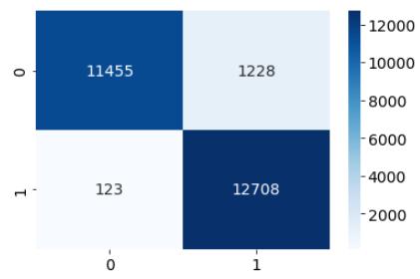
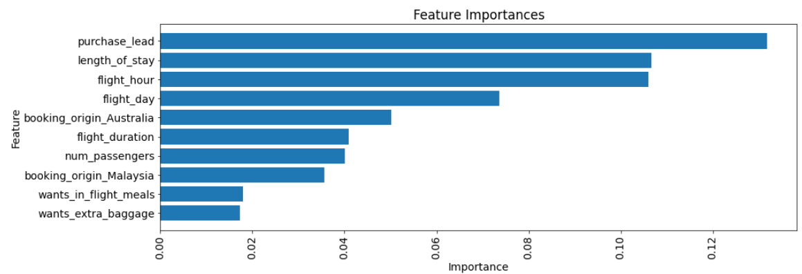
Predicting customer buying behavior model
Neutral Reviews – 360 ---------- 10.6% Word represented Most
Our flight booking prediction model achieved high accuracy (94.7%), precision (91.2%), recall (99.0%), and F1 score (94.9%).
The model correctly predicted the majority of flight bookings (True Positives and True Negatives) and had a low rate of false positives and false negatives.
These results demonstrate the effectiveness of our model in predicting flight bookings and can help our company optimize our booking process and improve customer satisfaction.
Summary of Model Performance
True Positives: 12,708
True Negatives: 11,455
False Positives: 1,228
False Negatives: 123

